Slide 1
WALMART SUPERSTORE SALES
Technology :Data collection, Data visualization , Power BI
Domain : Data visualization

Slide 2
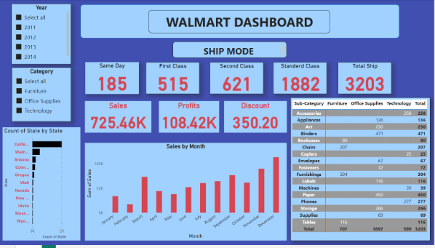
Overall Dash Board
This slide contains Overall Dashboard of walmart sales Report.
This Dashboard contains the sales report from the year 2011 – 2014
This Report contains Category and count of state by state and sales by Month with the year.
This Report shows Sales, Profit and Discount.

Slide 3
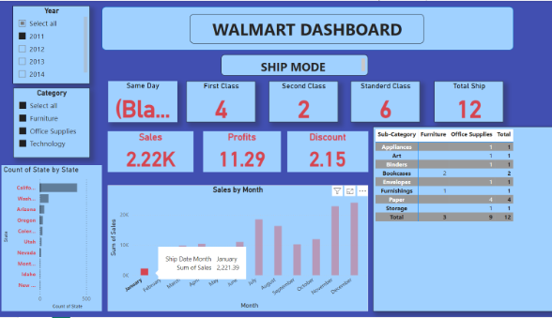
Image 1
This Report shows Ship Mode of Products and count state by state.
This Report shows Sales by Month.
This Report shows Product that saled in one year with profit and Discount.
This Report shows sub category of the Products

Slide 4
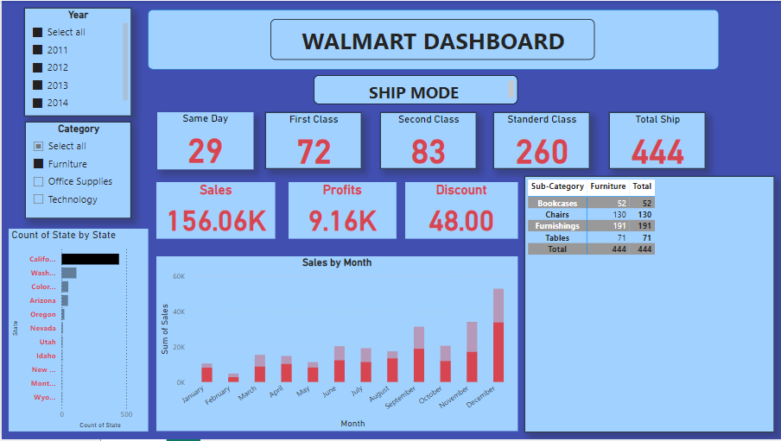
Image 2
This Image shows Overall sales of the Particular Product.
From Year 2011 – 2014 with count of state by state.
It shows the overall sales with Profit and Discount.

Slide 5
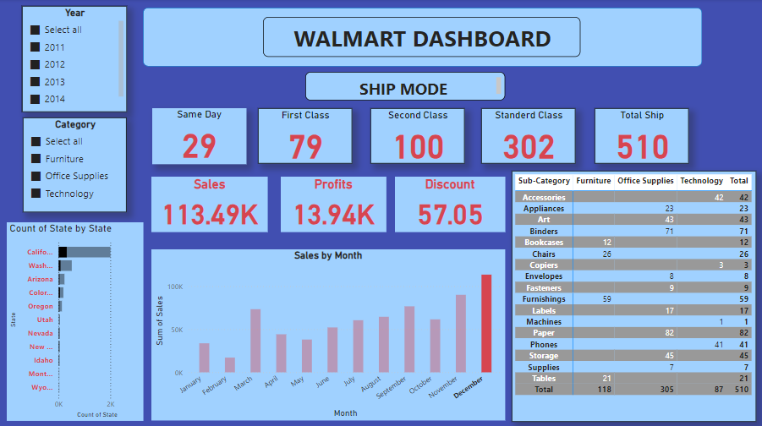
Image 3
This Report Shows all the Products saled in the Year 2011-2014 in a Overall State.
It shows the sales, Profit and Discount of the Particular Month.
And it also shows the Ship mode of the Products

Slide 6
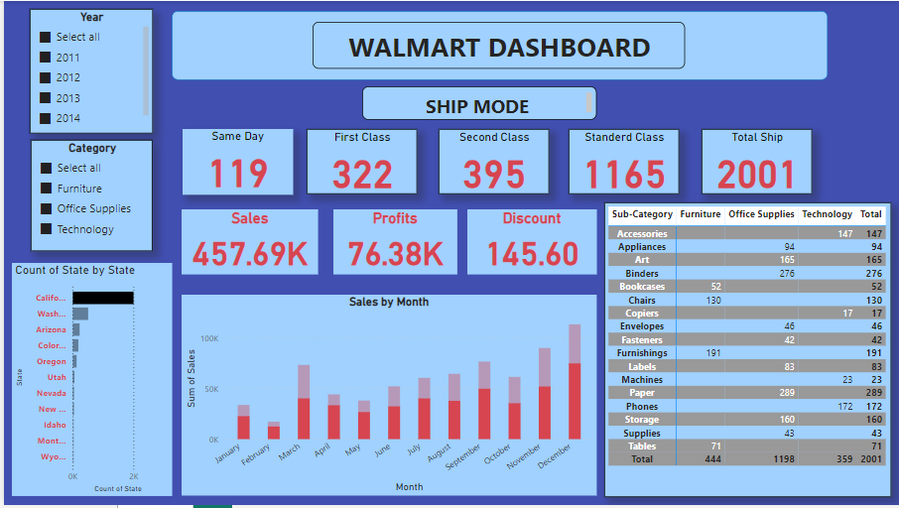
Image 4
This Report shows the Product saled in Overall Year from 2011-2014.
It contains all the Products saled in a particular state.
It shows the Product Sales of the Particular state with Profit and Discount.

Slide 7
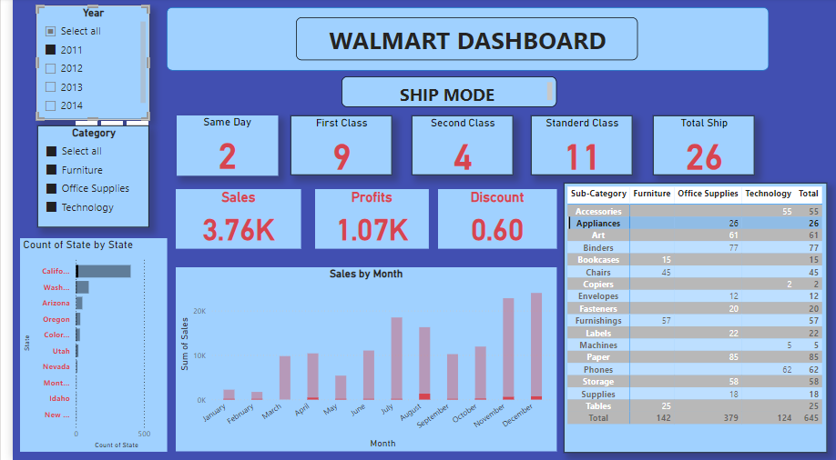
Image 5
This Report shows the one Product saled in a Particular Year.
In a count of state by state.
This Report also shows the Overall sale of the Product with Profit and Discount.

